Slide 1
Eigenfaces for Recognition Instructor: Stephanie Brandl
Andre Jansen, Sourabh Raj | Machine Learning
Notes:
Present yourself, say title

Slide 2

Structure
Introduction
Our paper
Our implementation
Advantages and disadvantages
Conclusion
Notes:
Andre
Short overview of the structure of our presentation
First we will give you an introduction to our topic
Then we will go into our paper, eigenfaces for recognition by Matthew Turk & Alex Pentland
Once idea of eigenface approach has been made clear we will show you what we did to implement this idea
Then we will do a demo run, where you will get to see all of this in action
Then to end of the presentation, we will highlight the advantages and disadvantages
And draw a conclusion

Slide 3
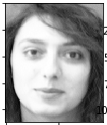

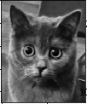
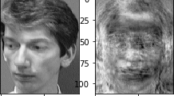
Introduction
Fast and simple way to face recognition, which performs well under certain circumstances.
If trained :
If not trained :
Recognition
Recognition
Notes:
Andre
To kick off, this approach aims to provide a fast and simple face recognition.
Consequence is that it performs well, only in certain conditions
Images give a hint of what is to come.

Slide 4
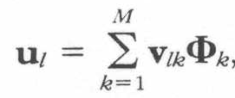
Our Paper – Eigenfaces Recognition Procedure
Collect a set of characteristic face images, this set should include images with varying expressions
Calculate the eigenvectors and eigenvalues, and choose K eigenvectors with largest associated eigenvalues.
Notes:
Andre
The steps shown in the paper regarding the eigenface recognition approach are as follows:
First you have to collect a data set of face images. A broad data set improves the quality of recognition
Now the eigenvectors and eigenvalues are calculated. The k eigenvectors with the largest associated eigenvalues are chosen

Slide 5

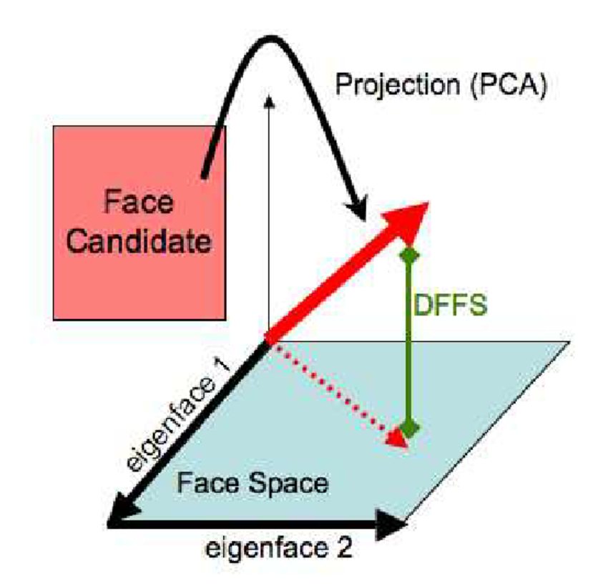
Our Paper – Eigenfaces Recognition Procedure
For each known individual, calculate the face class vector and then choose thresholds, one defining minimum allowable distance from the face class and other from face space.
Notes:
Andre
Finally we need a face class vector and then choose two thresholds, which are used to define the allowed distance from face class and face space separately
In the image you can see that you have to find a sensible distance in this example for face space, to classify a face candidate, or in our context test image, as a face

Slide 6



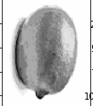
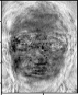
Our Paper – Eigenfaces Recognition Procedure
Calculate the pattern vector , the distance to each known class, and the distance to face space.
Pick one test image and project the image onto face space after centring the and normalizing the image. Reconstructed Non-face pictures can sometimes look like a face.
Reconstruction
Notes:
Andre
Then for each test face, calculate the pattern vector and the distance to each known class, as well as the distance to face space, as shown here.
The next step is to project the test image onto face space. It‘s important that the test images is centered and normalized
Sometimes this reconstruction can end up looking like a face.
In this case we projected a lemon onto face space and you can see hints of facial features.

Slide 7
Our Paper – Eigenfaces Recognition Procedure
If the new image is classified as unknown individual, then eigenfaces may be recalculated by adding the new picture in the set of familiar faces. This enlarges the scope of face recognition
Notes : Calculating eigenfaces can be very expensive for the large set of data so preferably should be done on an offline system. It is sometimes preferable to use SVD as it is computationally efficient.
Notes:
Andre
Then the paper gives an optional step, which consists of classifying test images as unknown face.
Adding this face to the set of familiar faces, and recalculating the eigenfaces will make it possible to recognize this individual in the future.
For a large data set it can become computationally very expansive to calculate the eigenfaces using eigendecomposition.
Later we will show you how we solved that in our implementation.

Slide 8
Issues:
Background: The background of image can have a significant effect on the face recognition accuracy and performance.
Scaling: Size of face/head can have striking effect on the algorithm accuracy.
Orientation: A non-straight face can result into a very wrong recognition.
Distribution in Face space: We assume that the distribution is Gaussian, we rather want to characterize it.
Multiple view is not supported by the algorithm yet and is prone to misalignment.
Notes:
Sourabh Raj : Talk about issue

Slide 9
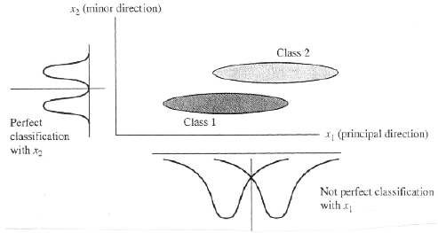
Issues: Cont..
PCA is not always an optimal dimensionality-reduction procedure for classification :-
Notes:
Sourabh Raj : Talk about PCA

Slide 10
Experiments:
Static Recognition: 2500 Images, 16 Person and using 6 level gaussian distribution pyramid.
Real-Time Recognition: A camera fixed in a room and a Datacube image processing system.
Detect a moving object, identify the head and when head is found run the algorithm.
Analysis:
The performance mainly depends upon the relation between pixels, in case of head scaling the correlation between pixels get lost.
The threshold value also have dramatic effect on the performance.
Varying lighting | 96% correct classification
Head size and scaling | 85% correct classification
Head orientation | 64% correct classification
Notes:
Sourabh Raj : Talk about experiments.

Slide 11
Relation to Neural Network:
Biological Motivation:
Early development makes it appear as that biological face recognition mechanism may also be based on some low-level, two-dimensional image processing.
Eigenfaces approach somewhere qualitatively similar to biological system.
Change in face: Even humans have trouble recognising a face after changes.
Gradual changes like aging can be dealt with re-calculation of eigenfaces.
Quick changes like growing a beard have to proven fooling humans as well.
Lighting effects: Recognizing a face in dark is tricky for humans as well.
Notes:
Sourabh Raj : Neural network

Slide 12
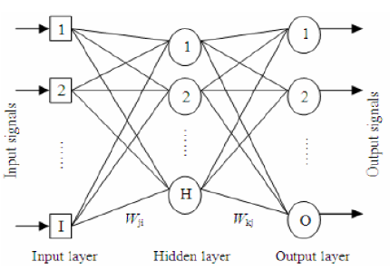
Relation to Neural Network: Cont..
Neural Networks: Eigenfaces approach can be implemented using parallel computing elements in the form of three layer liner network.
Notes:
Sourabh Raj : Three layer linear network

Slide 13
Our Implementation
Our face recognition implementation:
As described by steps in the paper (shown before)
Images used are read from training folder, or test folder as needed
Eigenfaces are calculated using singular value decomposition
Notes:
Andre
So now moving on from the theory to our implementation.
When implementing this approach we just followed the papers steps explained before.
The images are read from a training folder and a test folder as required by the experiment.
The eigenfaces are calculated using singular value decomposition, before we mentioned that it‘s expansive to calculate the eigenvectors of the covariance matrix of the set of face images.
The solution is to use singular value decomposition.

Slide 14
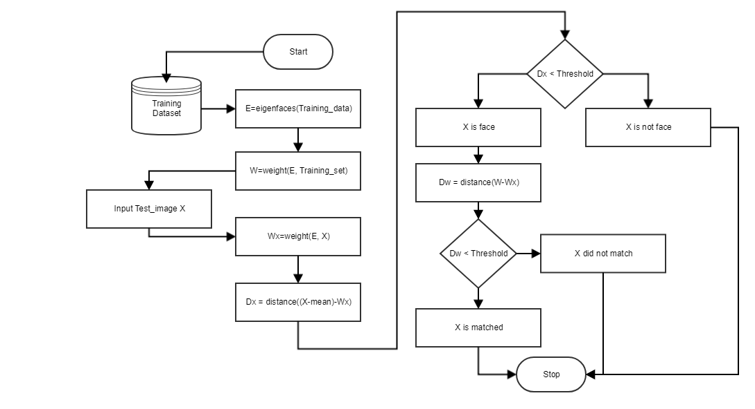
Our Implementation – Flow Chart
Notes:
Sourabh Raj: Explain the flow the code is written.

Slide 15





Our Implementation – Training image set
We used following face databases, made available by the Open Source Computer Vision Library (OpenCV):
AT&T Facedatabase, sometimes “ORL Database of Faces”. Consists of 40 subjects, 10 images each. Same background, sometimes with glasses, eyes closed or smiling. Lighting is not similar. (credit to “AT&T Laboratories, Cambridge)
The extended Yale Face Database B consists of 28 subjects, with 9 poses and 64 different lighting conditions.
Notes:
Andre
In the eigenfaces implementation we used the AT&T Facedatabase, which consists of 40 subjects.
For each subject the database provides 10 different images, either from a slightly different angle, a different expression and so on.
On the bottom here we have subject one from the AT&T Facedatabase.
Then we also used the extended yale face database b which contains 28 subjects, each with 9 different poses, and 64 different lighting conditions.

Slide 16




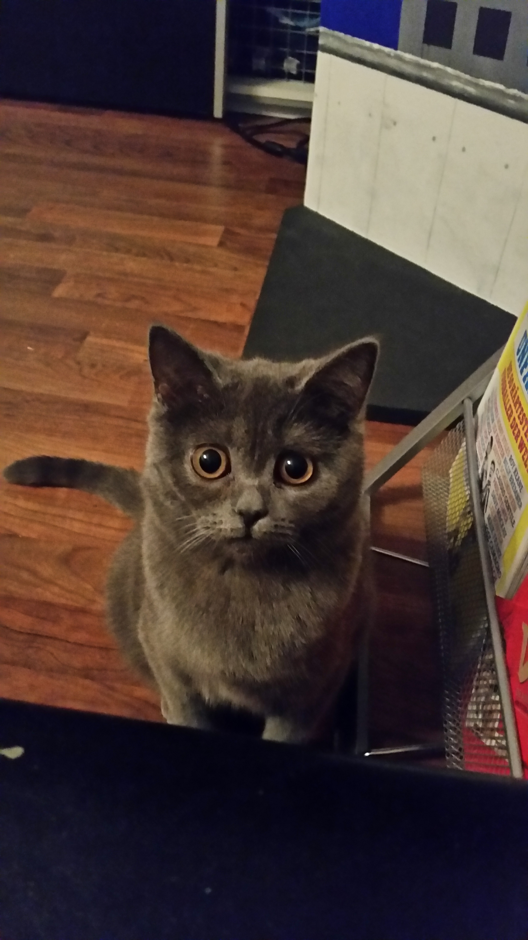




Our Implementation – Training image set
Notes:
Andre
Last but not least we added some pictures to test our algorithm.
The left cat by the way is my cat, she‘s called chloey, we used her and another cat from the web to train with these two cats and then see what happens with different test images.
You will get to see the results later.

Slide 17
Our Implementation – Testing image set
Test image set contains the images which are to be identified by implementation:
Selected images from training image set
Additional images to see how implementation performs from the web.
Notes:
Andre
That was it for our training image set, now we move to our testing image set.
These are the images which were supposed to be recognized.
Some of them where cut from the training image dataset, others were created by ourselves as shown in the training image set, and then again we took some images from the web.

Slide 18
Our Implementation (Data matrix)
Each row of data matrix consists of flattened image from the training image set
Data matrix visualization:
Image 0
Image 1
.
.
Image n
Notes:
Andre
So we now had our training image set. We just flattened each of these and that way built our data matrix, as visualized here.

Slide 19
Our Implementation (Singular value decomposition)
Principal component analysis with singular value decomposition :
Computationally more efficient then classic way of eigendecomposition
The average face has been calculated and subtracted from data matrix before svd
Function in python for singular value decomposition we used is:
np.linalg.svd(D), where D is our data matrix
Returns eigenvectors as well as singular values
Notes:
Andre
Using singular value decomposition, and an average face which was calculated using the data matrix before,
we then got our eigenfaces and singular values

Slide 20
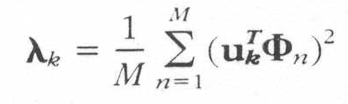
Our Implementation (Determine “k” highest eigen values)
Performing PCA on the input Data matrix gives us K orthonormal vectors which best describes the distribution of data.
These K orthonormal vectors are the in ascending order in respective of their magnitude.
Notes:
Sourabh Raj : K highest eigen values

Slide 21
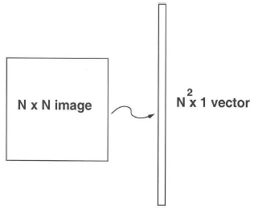
Our Implementation (Project to face space)
Each eigenvector define the subspace of face image, which we call face space.
Each vector describes N by N image and is linear combination of the original face.
Notes:
Sourabh Raj : Face space.

Slide 22
Our Implementation (Face identification)
A test image is recognized as a face by the following:
First the closest match for test image to training image is found
This is done by calculating the distance between images
Then by using the determined threshold it is checked whether:
The test image is a face
The test image has been matched to a face in training image set
Notes:
Sourabh Raj : Face identification

Slide 23
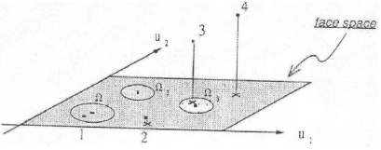
Our Implementation (Face identification): Cont…
Face recognition follows below criteria to match a face.
IN face space AND close to a given face
IN face space but NOT close to any given face
NOT in face space AND close to a given face
NOT in face space and NOT close to any given face
Notes:
Sourabh Raj

Slide 24
Demo
Notes:
Here we show the ipynb :

Slide 25
Advantages
Does not require complex three-dimensional models
Relatively simple way of face characterization
Performs well if provided images meet certain requirements
Notes:
Andre
The advantages of this approach are:
The fact that you only need 2d data which is not that complex and therefore simpler to interpret and easier to obtain as well
The algorithm itself is not too complicated to implement and understand, it‘s a simple way of approaching face recognition
It provides well if the quality of the training images, the lighting and so on is good. And if the image to be recognized is similar to the conditions of the training images. Hence it only performs well in restricted boundaries.

Slide 26
Disadvantages
As shown before, when addressing the issues:
Does not take into account three-dimensionality of human faces
Does not work if background varies strongly, lighting is bad etc.
Notes:
Andre
What we just said for the advantages, has it‘s negative side as well.
Since we don‘t take into account the three dimensionality of human faces, recognition might not be as precise as possible
The conditions under which this will perform well are so restrictive, that this approach is not made for many use cases of face recognition

Slide 27
Conclusion
Eigenfaces algorithm is not a perfect solution to face recognition problem but is quite well fitted. However, In terms of robustness and accuracy, still a lot of work is needed to be done.
Some suggested enhancement may look like follows:
Centring the face using 2-dimensional gaussian window might be used to tackle the background problem by diminishing the background and accentuating the middle face.
Rescaling the head size to fit the eigenface size can deal with scaling inaccuracy.
An accurate estimation of head orientation may be helpful to align the head in upright view and can benefit the algorithm.
Rather than assuming the face space a gaussian distribution, characterization should be done.
Face class should be defined for each known person’s characteristic multiple view.
Notes:
Sourabh Raj

Slide 28
Thank you for listening!

Slide 29
Template (PLEASE KEEP THIS UNTIL END)
Fließtext Blindtext arcilis ipsuntis mil il Hervorhebung im Fließtext cupti qui blandig endella borehent,
aliciae labores molor sum fugiate cullatusam:
Kipitium quae quiatus andandunt landio et aut mi
Neseque volenisci vellacearit harum velestis reicipis as ipsum quodicipsunt velectur
Sunt alisinvel essi nia quam quid
Eum dolupta turit, con nobis et volore, opta con corro doluptas dolupis doluptas dolu
Ventore ntiusam aspelignim
Volore dolecta turibus, quibea consequo experit aspero velluptas nos conseri orempos
Ad milliassi solorio molupta pe inciatiis eniet earu
Hervorhebung als Fazit Blindtext suntis mil il moloribus cupti qui blandig endella borehent.

